Slide 1
Time Series Analysis : ARIMA
Nanda Fadhli

Slide 2
Outline
01
Introduction
02
AR & MA Model
03
ARIMA Model
04
ARIMA with Python & Diagnostics

Slide 3
Introduction
Fundamental Concepts

Slide 4
ARIMA(p, d, q) Model
also known as Box-Jenkins models
1. AR(p)
Autoregressive with order p
Non Stationary Model
ARI(p,d), IMA(d,q), and ARIMA(p,d,q)
Stationary Model
AR(p), MA(q), and ARMA(p,q)
2. I(d)
Integrated with order d
3. MA(q)
Moving Average with order q
What is Stationary Time Series?

Slide 5
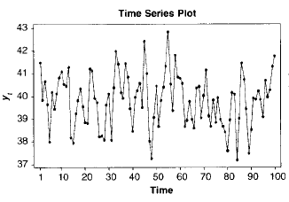
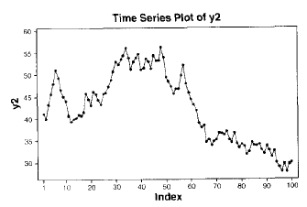
Definition
When n = 1 the (univariate) distribution of Yt is the same as that of Yt − k for all t and k; in other words, the Y’s are (marginally) identically distributed.
It then follows that E(Yt) = E(Yt − k) for all t and k so that the mean function is constant for all time.
Additionally, Var(Yt) = Var(Yt − k) for all t and k so that the variance is also constant over time.
Stationary
Cryer, J.D and Chan, K.S. 2008. Time Series Analysis with Application in R. Springer
(1)
(2)
Which one is Stationary Data?

Slide 6
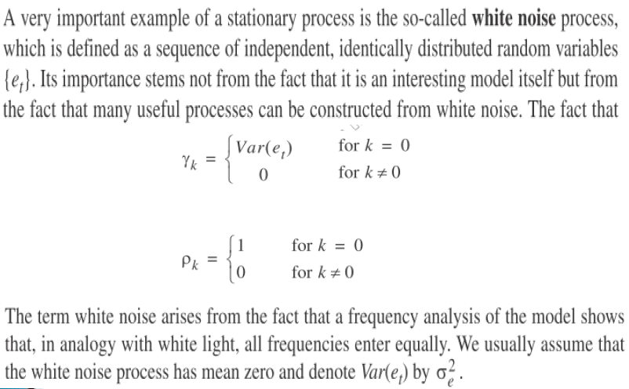
Definition
White Noise
Normalitas
Homogenitas
Autokorelasi
Cryer, J.D and Chan, K.S. 2008. Time Series Analysis with Application in R. Springer
In the other words, White noise is the condition
where the errors satisfy all of assumptions

Slide 7
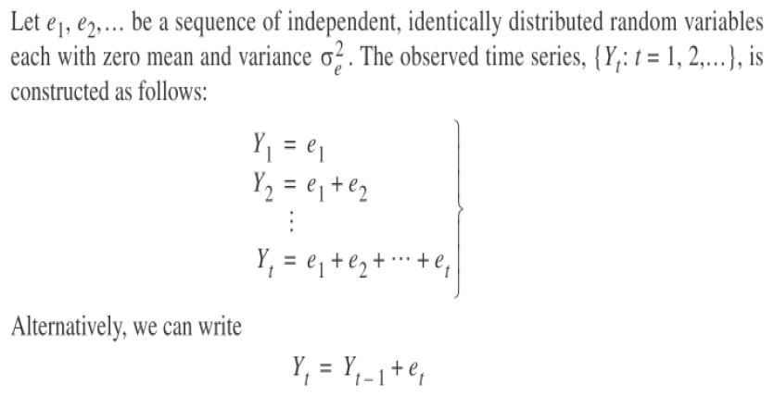
Definition
Random Walk
white noise
Cryer, J.D and Chan, K.S. 2008. Time Series Analysis with Application in R. Springer

Slide 8
Autoregressive (AR) &
Moving Average (MA) Model
(Stationary Model)

Slide 9
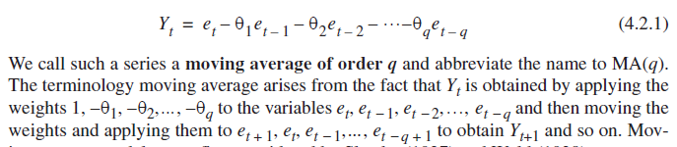
Moving Average / MA (q) Model
General Equation of MA (q)
Cryer, J.D and Chan, K.S. 2008. Time Series Analysis with Application in R. Springer

Slide 10
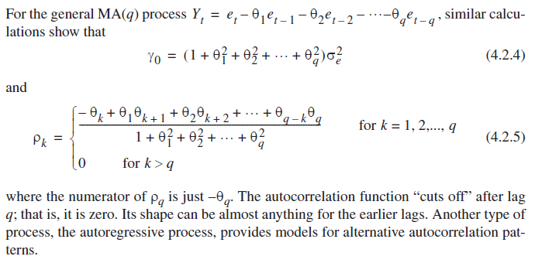
Moving Average / MA (q) Model (cont.)
Cryer, J.D and Chan, K.S. 2008. Time Series Analysis with Application in R. Springer

Slide 11
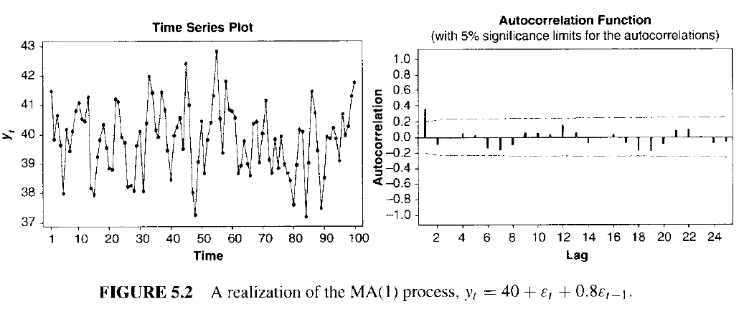
Moving Average / MA (q) Model (cont.)
Montgomery, D.C., et.al.2008. Forecasting Time Series Analysis 2nd. John Wiley

Slide 12
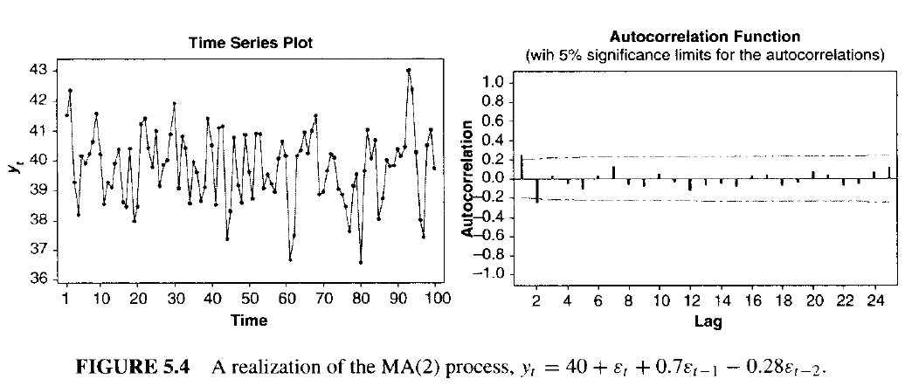
Moving Average / MA (q) Model (cont.)
ACF PLOT
Montgomery, D.C., et.al.2008. Forecasting Time Series Analysis 2nd. John Wiley

Slide 13
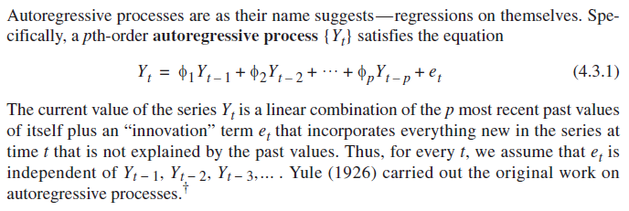
Autoregressive / AR (p) Model
General Equation of AR (p)
Cryer, J.D and Chan, K.S. 2008. Time Series Analysis with Application in R. Springer

Slide 14
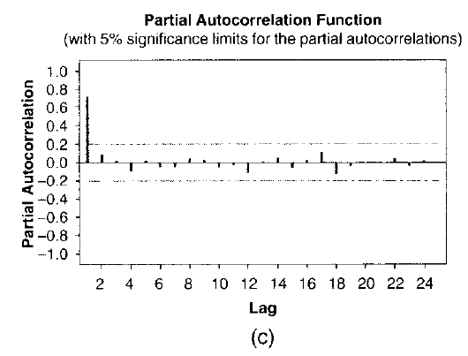
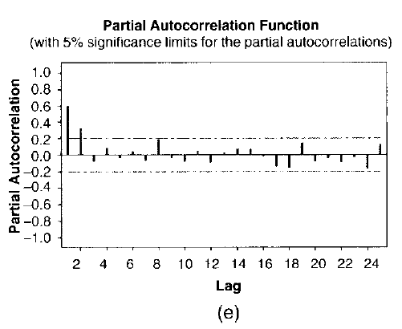
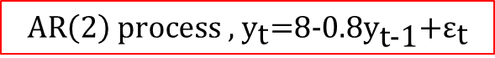

AutoRegressive / AR (p) Model (cont.)
PACF PLOT
$${\text{AR}\left(\text{1}\right) \text{process}\text{ , }\text{y}}_{\text{t}}\text{=8+0.8}{\text{y}}_{\text{t}\text{−1}}\text{+}{\text{ε}}_{\text{t}}$$
$${\text{AR}\left(\text{2}\right) \text{process}\text{ , }\text{y}}_{\text{t}}\text{=8−0.8}{\text{y}}_{\text{t}\text{−1}}\text{+}{\text{ε}}_{\text{t}}$$
Montgomery, D.C., et.al.2008. Forecasting Time Series Analysis 2nd. John Wiley

Slide 15
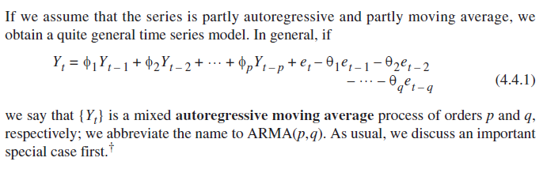
ARMA (p, q) Model
Cryer, J.D and Chan, K.S. 2008. Time Series Analysis with Application in R. Springer

Slide 16
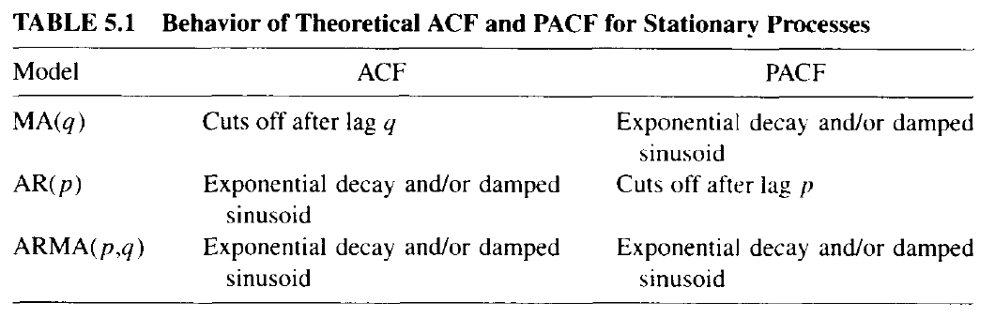
ARMA (p, q) Model
Montgomery, D.C., et.al.2008. Forecasting Time Series Analysis 2nd. John Wiley

Slide 17
Autoregressive Integrated
Moving Average (ARIMA) Model
(Non - Stationary Model)

Slide 18
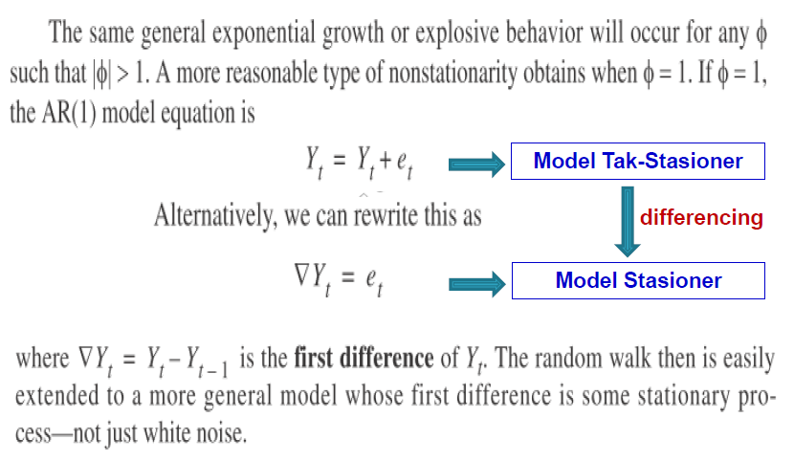
Differencing
Cryer, J.D and Chan, K.S. 2008. Time Series Analysis with Application in R. Springer

Slide 19
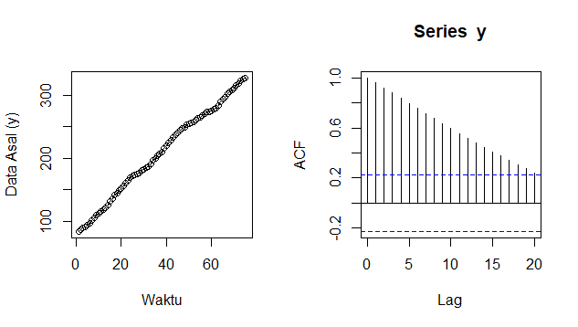
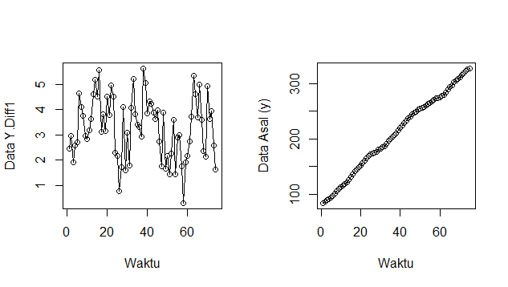
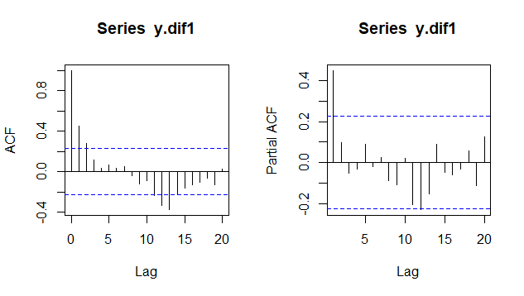
ARIMA (p, d, q) Model
Data have an exponential decay that indicate non-stationary data. Need to be differenced
First differencing (d=1)
Model we got is
ARIMA (1, 1, 2)
The plot indicates data already stationary, then check ACF & PACF plot

Slide 20
ARIMA with Python & Diagnostics
Let’s Jump into Jupyter Notebook !

Slide 21

Thank You
By : Nanda Fadhli

Slide 22
References
Cryer, J.D and Chan, K.S. 2008. Time Series Analysis with Application in R. Springer
Montgomery, D.C., et.al.2008. Forecasting Time Series Analysis 2nd. John Wiley
Several of slides were modified from Dr. Kusman Sadik, M.Si (Statistics Departement, IPB University)

